Slide 1
Strings and Files
HIT137 Software Now
Week 03

Slide 2

We extend our respect to Elders - past, present and emerging - and to all First Nations people.

Slide 3



Please download and install the Slido app on all computers you use
How clear and understandable was the content presented in last two lecture sessions?
ⓘ Start presenting to display the poll results on this slide.

Slide 4
Please download and install the Slido app on all computers you use
How effective was the lecturer (Thuseethan) in explaining the topics?
ⓘ Start presenting to display the poll results on this slide.

Slide 5


Outline
Understanding of:
Logical operators
Strings
Cryptography using strings
Handling files

Slide 6
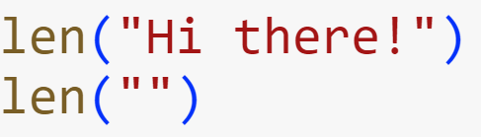
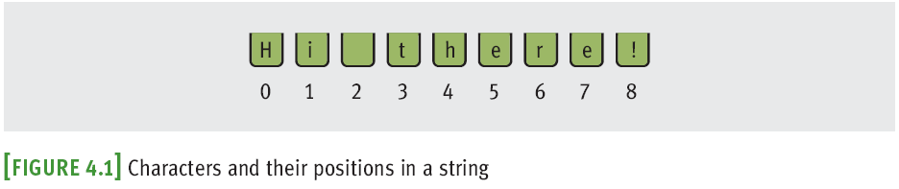
Accessing Characters and Substrings in Strings
In this section, we examine the internal structure of a string more closely
You will learn how to extract portions of a string called substrings
A string
Data structure: Consists of smaller pieces of data
String’s length: Number of characters it contains (0+)

Slide 7
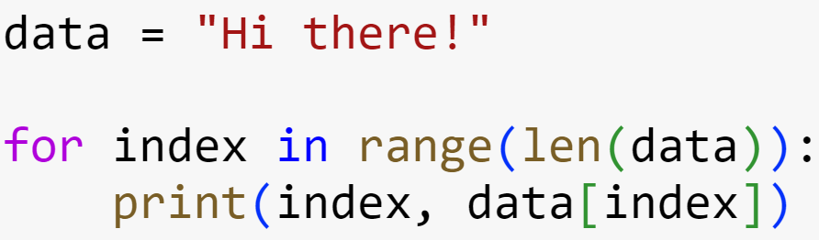

The Subscript Operator
Subscript operator is useful when you want to use the positions as well as the characters in a string
Use a count-controlled loop
Output:

Slide 8
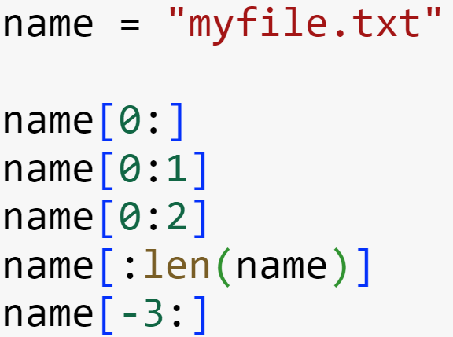
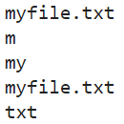
Slicing for Substrings
Python’s subscript operator can be used to obtain a substring through a process called slicing
Place a colon (:) in the subscript; an integer value can appear on either side of the colon
Output:

Slide 9
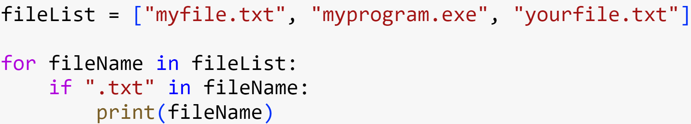

Testing for a Substring with the in Operator
When used with strings, the left operand of in is a target substring and the right operand is the string to be searched
Returns True if target string is somewhere in search string, or False otherwise
Output:

Slide 10
Practice
Refer to Week 3 PDF_CODE

Slide 11
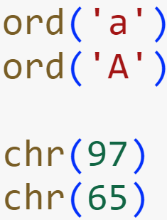

Character Sets
In Python, character literals look just like string literals and are of the string type
They belong to several different character sets, among them the ASCII set and the Unicode set
ASCII character set maps to set of integers
ord and chr convert characters to and from ASCII
Output:

Slide 12
Data Encryption
It is easy to observe data crossing a network, particularly in wireless networks
Attacker may use sniffing software
Data encryption can be used to protect information transmitted on networks
Many protocols have secure versions (e.g., HTTPS)
One or more keys are used to encrypt messages to produce cipher text, and to decrypt cipher text back to its original plain text form
Examples: Caesar cipher, block cipher

Slide 13
Practice
Refer to Week 3 PDF_CODE

Slide 14
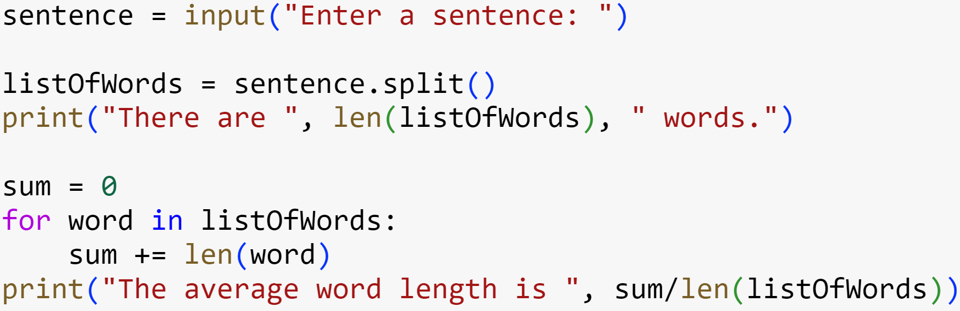

String Methods
Python includes a set of string operations called methods that make tasks like counting the words in a single sentence easy.
Output:

Slide 15
String Methods
A method behaves like a function, but has a slightly different syntax
A method is always called with a given data value called an object
Methods can expect arguments and return values
A method knows about the internal state of the object with which it is called
In Python, all data values are objects

Slide 16
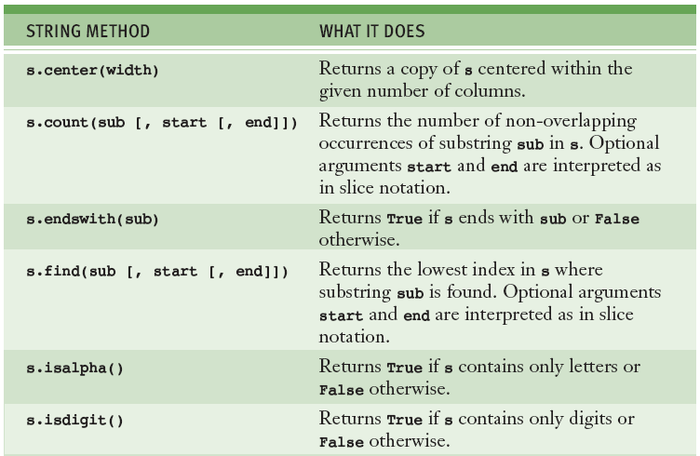
String Methods

Slide 17
String Methods

Slide 18
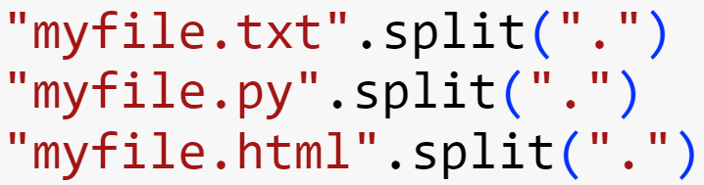

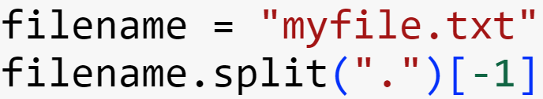

String Methods
Example: extracting a filename’s extension
The subscript [-1] extracts the last element
Can be used to write a general expression for obtaining any filename’s extension, as follows:
Output:
Output:

Slide 19
Practice
Refer to Week 3 PDF_CODE

Slide 20
Text Files
A text file is software object that stores data on permanent medium such as disk or CD
When compared to keyboard input from human user, the main advantages of taking input data from a file are:
The data set can be much larger
The data can be input much more quickly and with less chance of error
The data can be used repeatedly with the same program or with different programs

Slide 21
Writing Text to a File
Data can be output to a text file using a file object
To open a file for output:
If file does not exist, it is created
If it already exists, Python opens it; when data are written to the file and the file is closed, any data previously existing in the file are erased

Slide 22
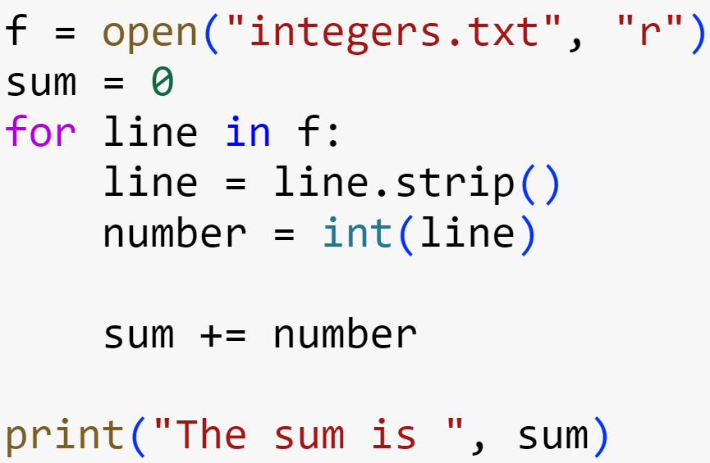
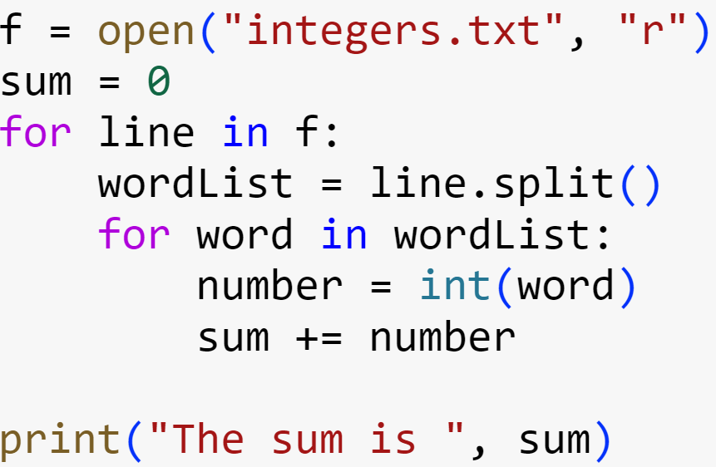

Reading Numbers from a File
Output:

Slide 23
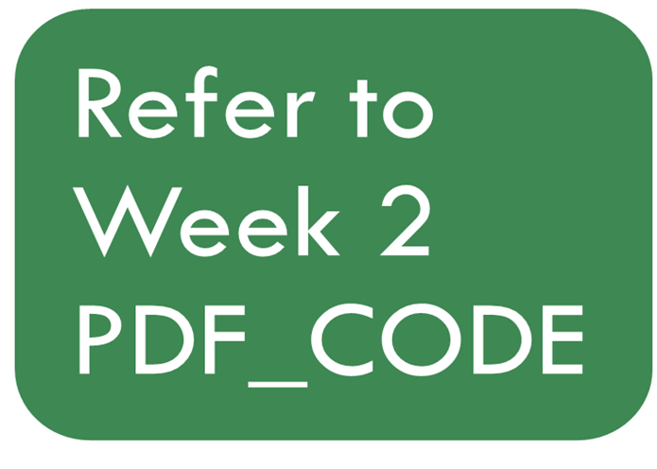
Practice

Slide 24
Tutorial Session
Start Solving Tutorial Questions

Slide 25
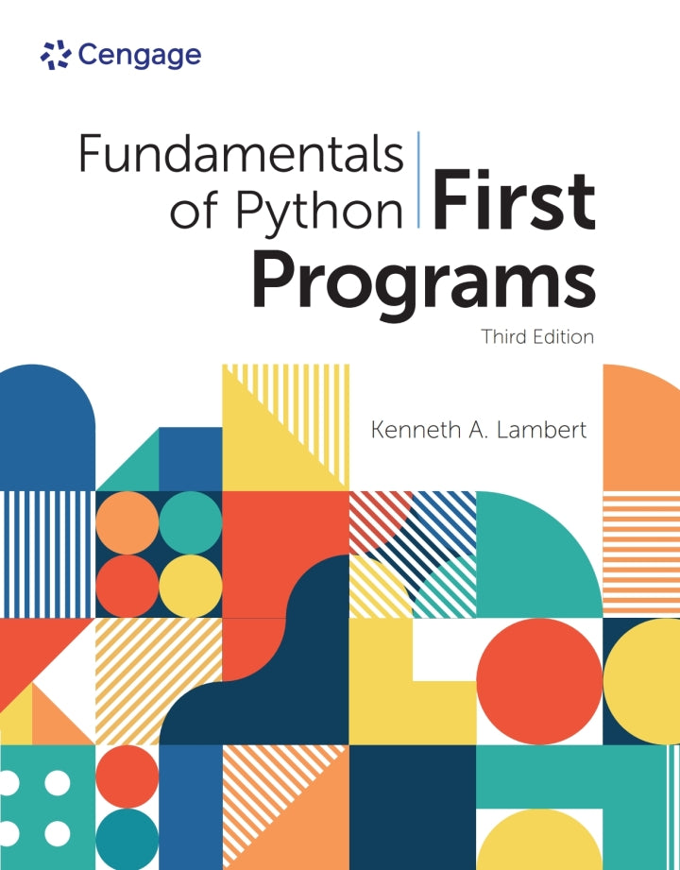
Resources
Some great resources to start your work :
Fundamentals of Python: First Programs
https://www.w3schools.com/python/default.asp
https://python.swaroopch.com/

